Slide 1

GROUP 3 CAPSTONE PROJECT
DSF-PT08 PHASE V

Slide 2
GROUP MEMBERS
Mercy Juma mercy.juma@student.moringaschool.com
Shadrack Macharia shadrack.macharia@student.moringaschool.com
Hezekia Asaava hezekia.asaava@student.moringaschool.com
Mitchelle Joy Wayua mitchelle.wayua@student.moringaschool.com
Ndung’u Mburu ndung’u.mburu@student.moringaschool.com
AbdirahMan Abdi abdirahman.abdi@student.moringaschool.com

Slide 3
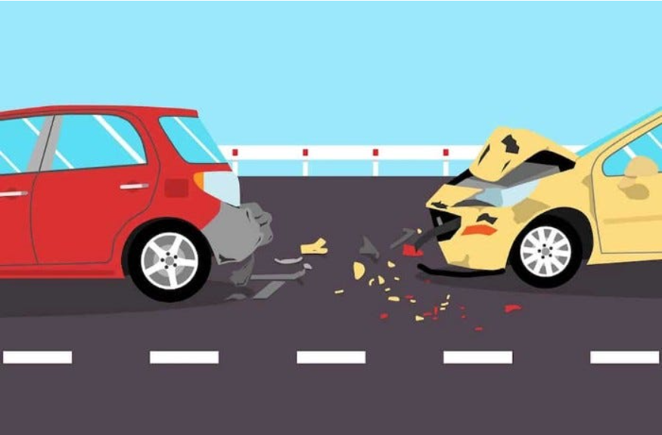
TITLE:PREDICTING TRAFFIC ACCIDENT SEVERITY

Slide 4
PRESENTATION OUTLINE
PROJECT BACKGROUND
OBJECTIVE
DATA UNDERSTANDING
EXPLORATORY DATA ANALYSIS (EDA)
MODELING & ANALYSIS
RESULTS & FINDINGS
CONCLUSION

Slide 5
BACKGROUND
Traffic accidents are a global concern, often due to the devastating consequences such as injuries, fatalities, and financial losses. Accidents severity is influenced by environmental, temporal and human factors. Understanding the role this variables play in determining accident severity can be critical for addressing public safety challenges.
The interplay between these factors creates a complex web of influences on accident severity. This project develops a predictive model that can estimate the severity of traffic incidents based on various parameters such as weather, nature of roads surface, time, day, among others .This initiative is not just about reducing the severity but also addresses the broader goal of integrating data science into urban planning and public safety decisions.

Slide 6
OBJECTIVES
Identify high-risk neighborhoods and geographical hotspots for traffic incidents through geospatial mapping.
Build a predictive model: develop a machine learning model capable of predicting the severity of road traffic accidents based on relevant features such as vehicle type, casualty details, road type, location, weather conditions, and time-related factors.
Identify the most influential factors for predicting accident severity.

Slide 7
DATA UNDERSTANDING
The project utilizes traffic incident data from San Francisco open data source, to develop a model to predict the likelihood of incidents leading to severe outcomes.
The data comprises information on weather conditions(rainy, snow, fog etc. ), time-related elements (time of the day, day of the week, month etc.), temporal factors such as direction of travel, existence of control devices, road surface among others.

Slide 8
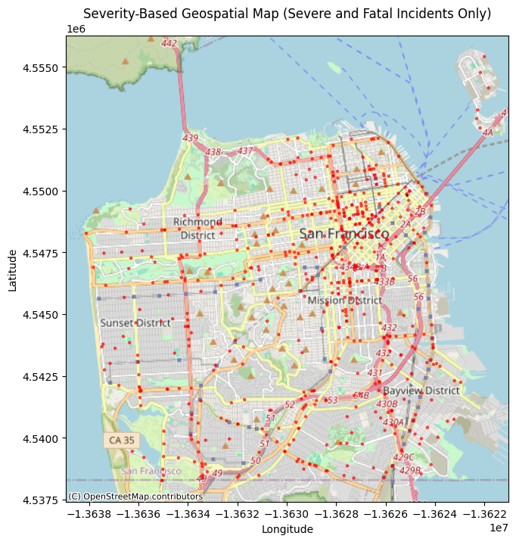
EXPLORATORY DATA ANALYSIS: GEOSPATIAL MAP
The map displays the geographical distribution of traffic incidents in SanFrancisco, categorized by severity.
The red points highlight the areas where fatal accidents occurred.
It is evident that the red points are clustered at intersections showing that these are blackspots.

Slide 9
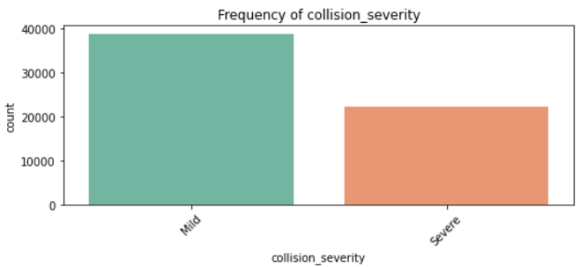
FREQUENCY OF COLLISION SEVERITY
Most accidents are classified as mild.
Takeout- There is class imbalance and hence most of the collision severities turned out to be mild than severe.

Slide 10
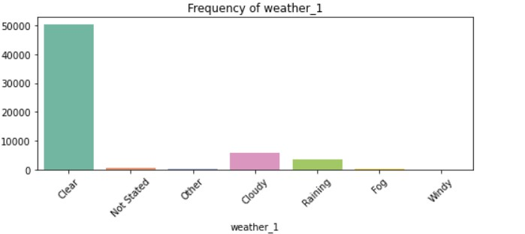
ACCIDENT FREQUENCY BY WEATHER
Most accidents occurred under clear weather.
Takeout- Collisions often occur in clear weather hence weather conditions are not the only factors contributing to accidents.

Slide 11
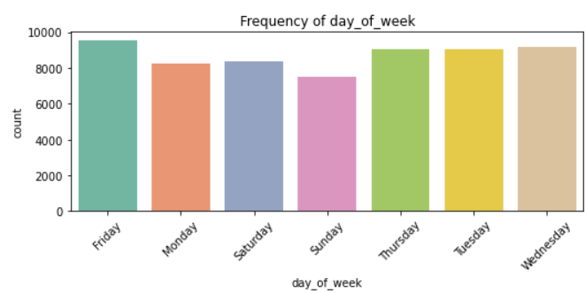
ACCIDENT FREQUENCY BY DAY OF THE WEEK
Most accident occur on Fridays , followed by Tuesday , Wednesday and Thursday.
Takeout-The pattern of traffic accidents suggests that Fridays are particularly hazardous, with the highest number of incidents, likely due to increased activity and travel before the weekend.

Slide 12
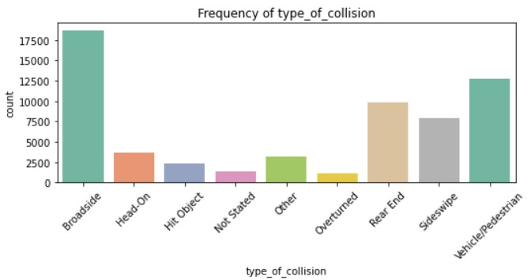
ACCIDENT FREQUENCY BY TYPE OF COLLISION
Broadside ,vehicle/pedestrian and rearend have the most frequent occurrences while overturned has the least occurrences.
Takeout-Broadside collisions, often occurring at intersections, highlight the importance of improving traffic signal management and promoting driver awareness to mitigate intersection-related risks.

Slide 13
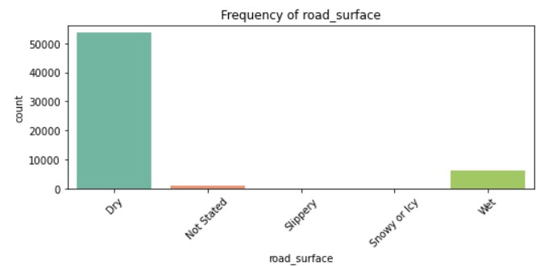
ACCIDENT FREQUENCY BY ROAD SURFACE
Most accidents occurred under dry road surface.
Takeout-Road surface don’t necessarily contribute to accidents , however other factors like driver fatigue ,
sobriety and vehicle condition may have greater implication.

Slide 14
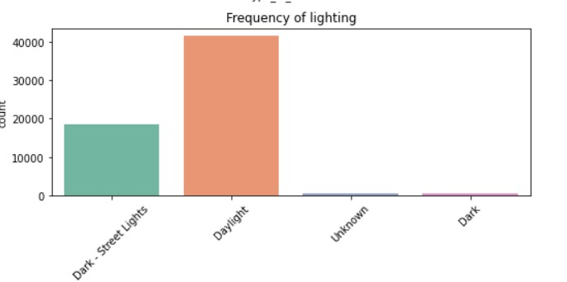
ACCIDENT FREQUENCY BY LIGHTING
Collision are most frequent during daylight condition followed by street lighted condition at night.
Takeout-Since most accidents have occurred during well lit conditions , hence proper lighting has minimal impact on occurrence of accidents

Slide 15
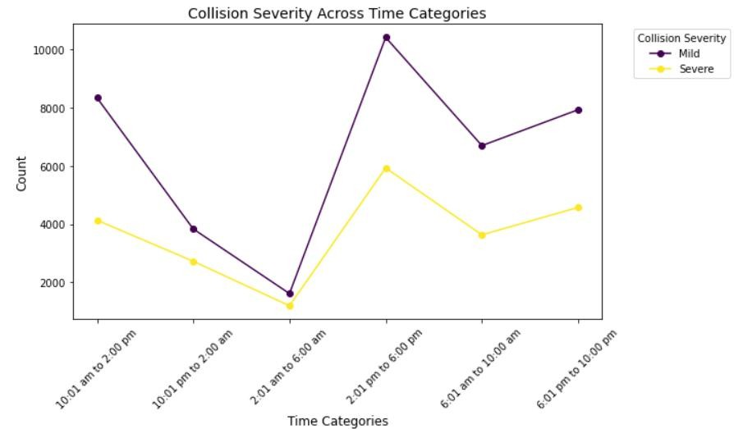
Collision severity across time categories
Time category 2:01pm to 6:00pm shows the highest collision counts for multiple severities while low collision counts occur during late night and early morning hours.
This indicates a high concentration of traffic activity or risk factors during this time period, possibly due to peak hours or increased road usage.
Takeout- Traffic safety interventions might be more effective if targeted at the afternoon to early evening and morning commute periods.

Slide 16
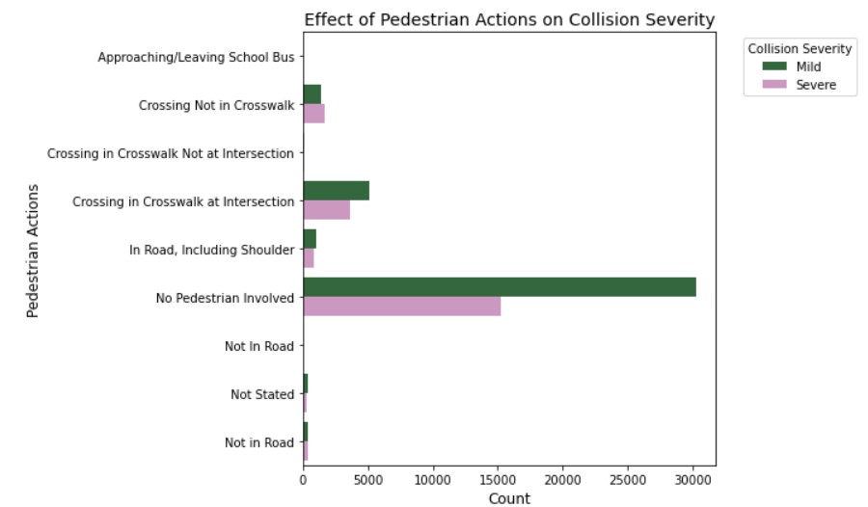
EFFECT OF PEDESTRIAN ACTION ON COLLISION SEVERITY
The category where no pedestrian is involved dominates the data. It highlights the dominance of vehicle-to-vehicle collision.
Takeout-This analysis highlights the importance of focusing safety interventions on high-risk pedestrian behaviors and locations, such as crosswalks at intersections.

Slide 17
MODELING AND ANALYSIS
The project is a classification problem and uses Logistic regression technique for a data analysis with comparative analysis with Random Forest Classifier, XGBoost ,Support Vector classifier and the K-Nearest Neighbor classifier.
From the analysis, Support Vector Classifier, Logistic Regression, and XGBoost are the best performing models for Mild collisions, with high recall and F1-scores, the overall accuracy for both models remained unchanged at 0.66.

Slide 18
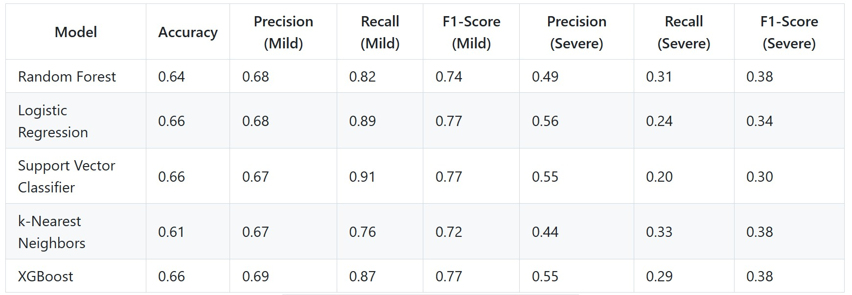
MODEL RESULTS
This table summarizes the Accuracy, Precision, Recall, and F1-Score for various models used in predicting collision severity. These metrics were chosen to evaluate the models effectively, especially in cases of class imbalance.

Slide 19
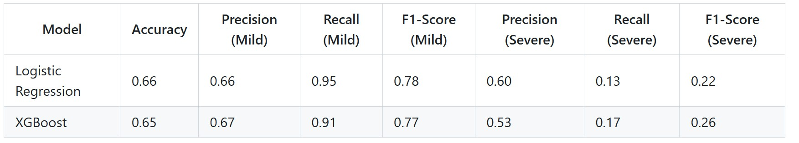
RESULTS AFTER FEATURE IMPORTANCE
Since both Random Forest and XGBoost are tree-based models, they inherently provide a measure of feature importance based on how much each feature contributes to reducing uncertainty.
After reviewing the top features from both models, we selected the following features for further modeling: 'distance', 'number_injured', 'day_of_week', 'party1_dir_of_travel', 'number_killed', 'type_of_collision', and 'party2_dir_of_travel'.
Overall, both Logistic Regression and XGBoost perform better with Mild collision predictions but still miss a significant number of Severe collisions. Improvements in identifying Severe cases could involve tuning the models further or using specialized techniques for class imbalance, such as oversampling Severe cases or using weighted loss functions.

Slide 20
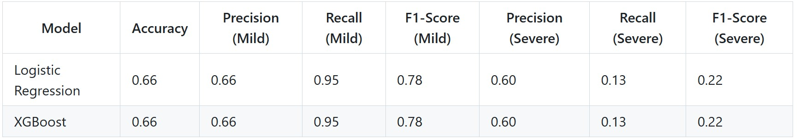
RESULTS AFTER HYPERPARAMETER TUNING
We utilized Grid search CV for Hyperparameter tuning picked the best parameters getting the results as shown above.
Both Logistic Regression and XGBoost perform similarly, with good performance on Mild collisions but significant difficulty with Severe collisions.
The models could be improved for Severe collision prediction with further tuning, resampling techniques, or alternative modeling approaches.

Slide 21
CONCLUSION

